Slide 1
Piecewise-linear transformation
Contrast stretching
Goal:
Increase the dynamic range of the gray levels for low contrast images
Low-contrast images can result from
  poor illumination
  lack of dynamic range in the imaging sensor
  wrong setting of a lens aperture during image acquisition
CUI, Lahore Campus -- CSC 331: Digital Image Processing -- © Dr. Usama Ijaz Bajwa

Slide 2
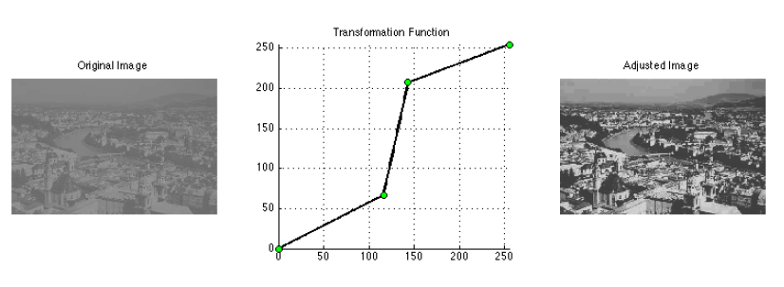
Piecewise-linear transformation
CUI, Lahore Campus -- CSC 331: Digital Image Processing -- © Dr. Usama Ijaz Bajwa

Slide 3
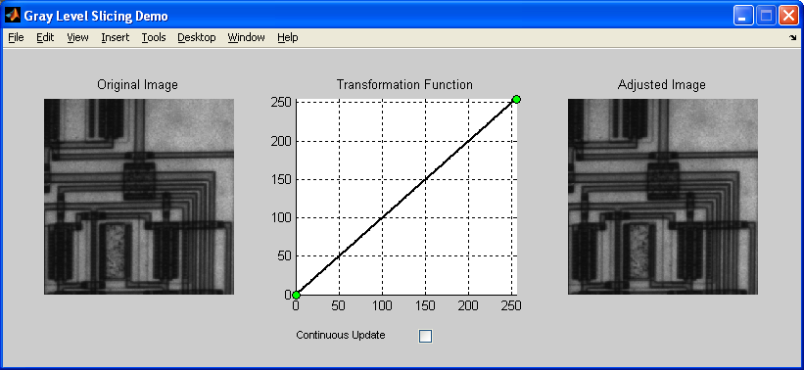
Piecewise-linear transformation
Specifying point transformations interactively
  glsdemo
CUI, Lahore Campus -- CSC 331: Digital Image Processing -- © Dr. Usama Ijaz Bajwa

Slide 4
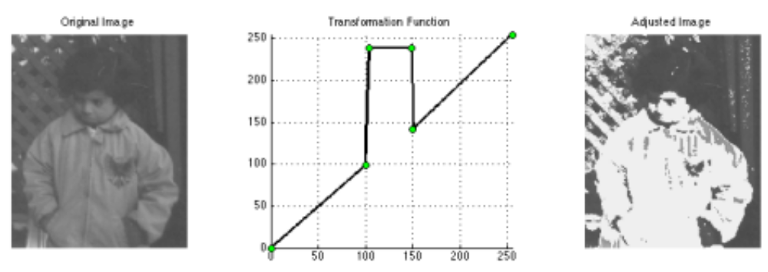
Piecewise-linear transformation (Intensity Level Slicing)
Specifying point transformations interactively
  glsdemo example
CUI, Lahore Campus -- CSC 331: Digital Image Processing -- © Dr. Usama Ijaz Bajwa

Slide 5
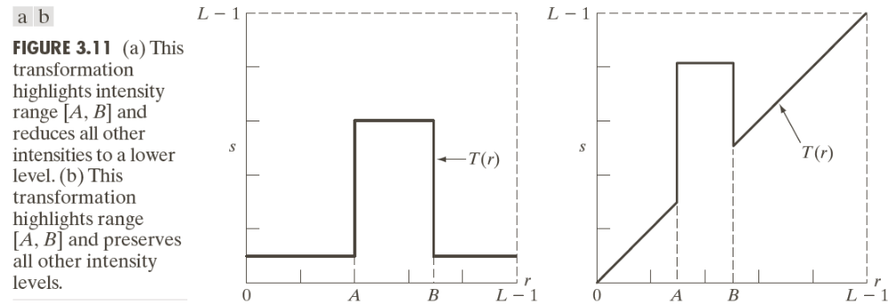
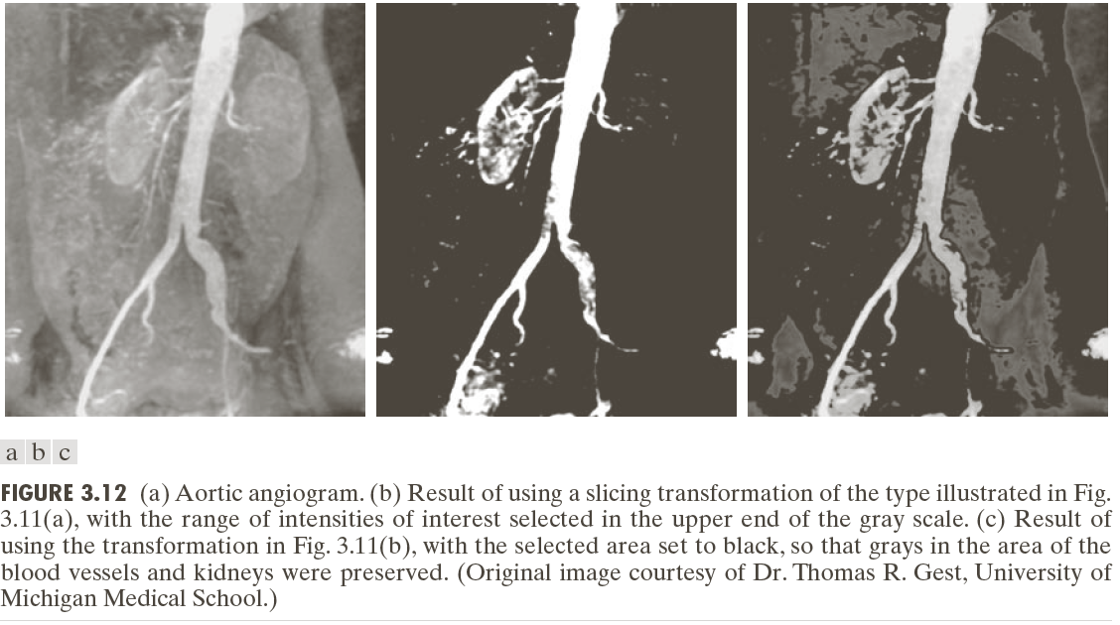
Piecewise-linear transformation (Intensity Level Slicing)
CUI, Lahore Campus -- CSC 331: Digital Image Processing -- © Dr. Usama Ijaz Bajwa

Slide 6
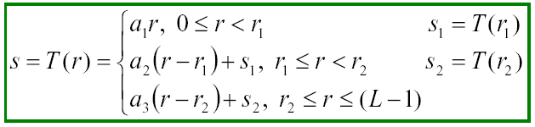
Piecewise-linear transformation: contrast stretching
Method
where a₁, a₂, and a₃ control the result of contrast stretching
if a₁ = a₂ = a₃ = 1 no change in gray levels
if a₁ = a₃ = 0 and r₁ = r₂, T(*) is a thresholding function,
the result is a binary image
CUI, Lahore Campus -- CSC 331: Digital Image Processing -- © Dr. Usama Ijaz Bajwa

Slide 7

Contrast Stretching Example
Form of Transformation function
Original low-contrast image
Result of contrast stretching
Result of thresholding
CUI, Lahore Campus -- CSC 331: Digital Image Processing -- © Dr. Usama Ijaz Bajwa

Slide 8
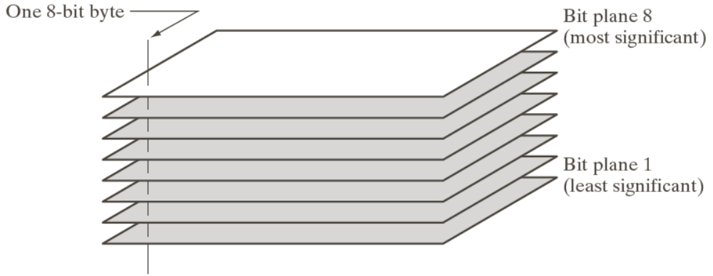

Bit-plane Slicing
CUI, Lahore Campus -- CSC 331: Digital Image Processing -- © Dr. Usama Ijaz Bajwa

Slide 9
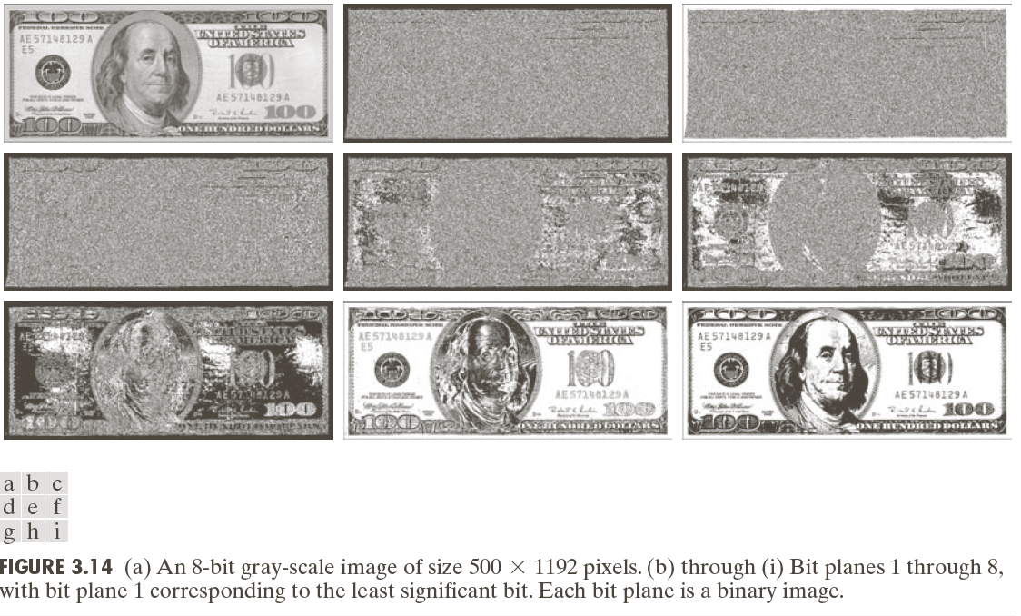
Bit-plane Slicing
Gray Level 194 at border of original image = 11000010
CUI, Lahore Campus -- CSC 331: Digital Image Processing -- © Dr. Usama Ijaz Bajwa

Slide 10
Bit-plane Slicing
In terms of intensity transformation functions :
Binary image for the 8th bit plane of an 8 bit image through a transformation function that maps all intensities between 0 and 127 to 0 and all levels between 128 and 255 to 1.
Exercise: Intensity transformation functions for generating other bit planes
Applications:
  Analyzing the relative importance of each bit in the image
  Determining the adequacy of the no. of bits used to quantize
  Useful for image compression, where fewer than all planes used in reconstruction of an image
CUI, Lahore Campus -- CSC 331: Digital Image Processing -- © Dr. Usama Ijaz Bajwa

Slide 11
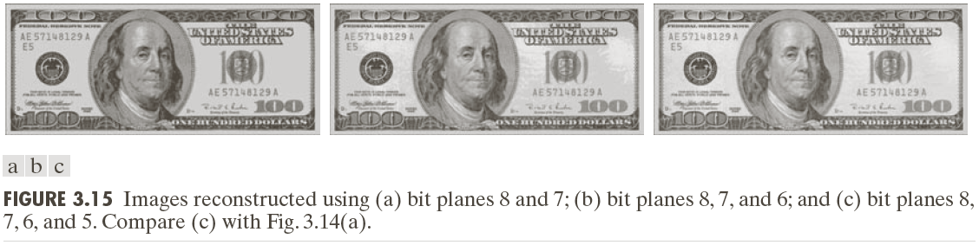
Bit-plane Slicing
Reconstruction done by multiplying pixels of n^{th} plane by a constant 2^{n-1} (Binary to Decimal conversion)
Each plane used, multiplied by corresponding constant and all planes used are added to obtain gray scale images.
CUI, Lahore Campus -- CSC 331: Digital Image Processing -- © Dr. Usama Ijaz Bajwa

